Slide 1
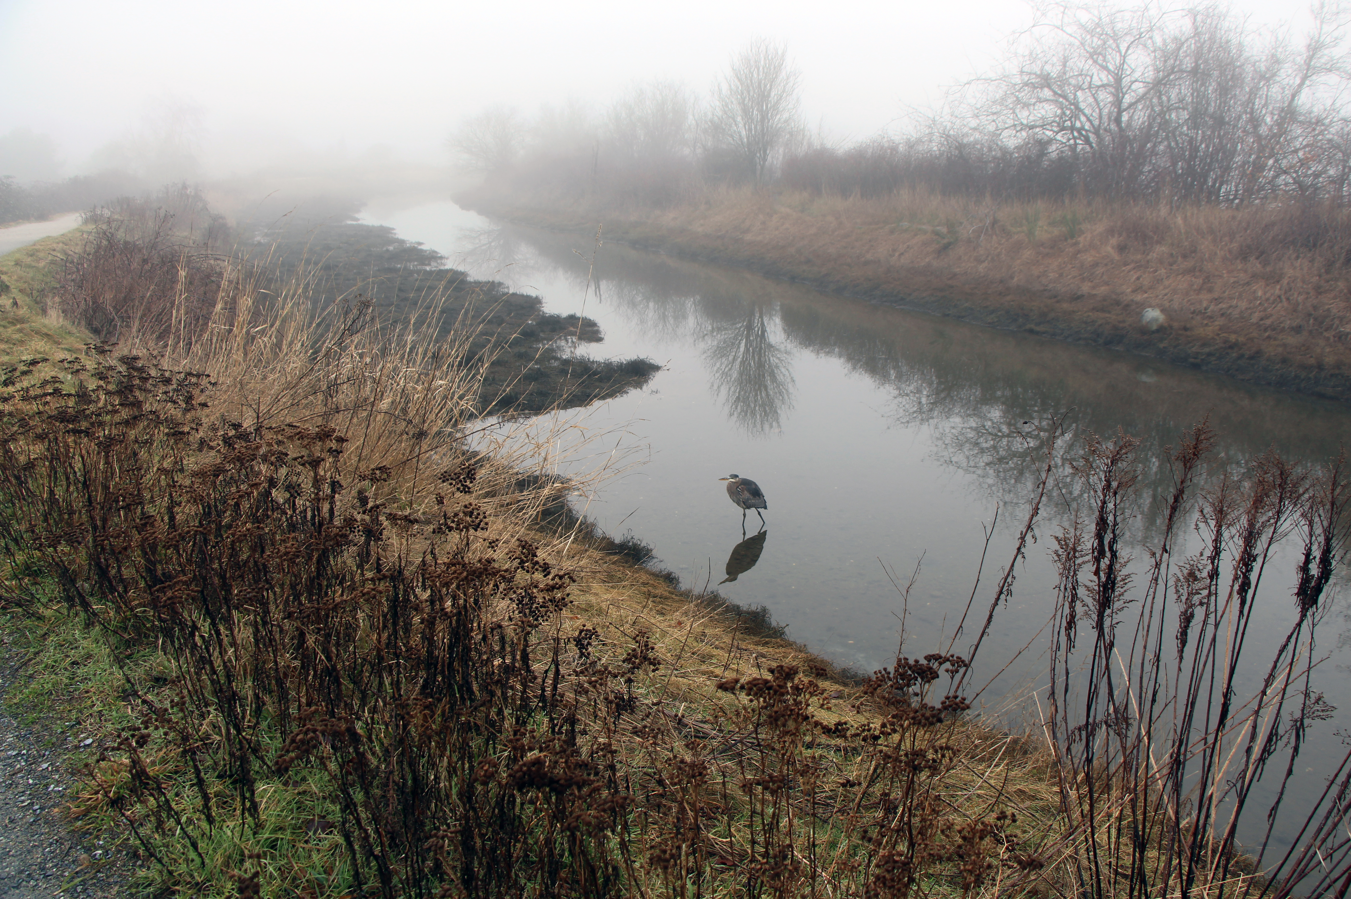
Pedagogy of Place & Sustainable Culture
In Defense of the Commons: A Manifesto for Sustainable Culture – Astra Taylor (2014)
The Mushroom at the End of the World: On the Possibility of Life in Capitalist Ruins – Anna Tsing (2016)
Between Geography and Philosophy: What Does it Mean to be in the Place-World? – Edward Casey (2001)

Slide 2
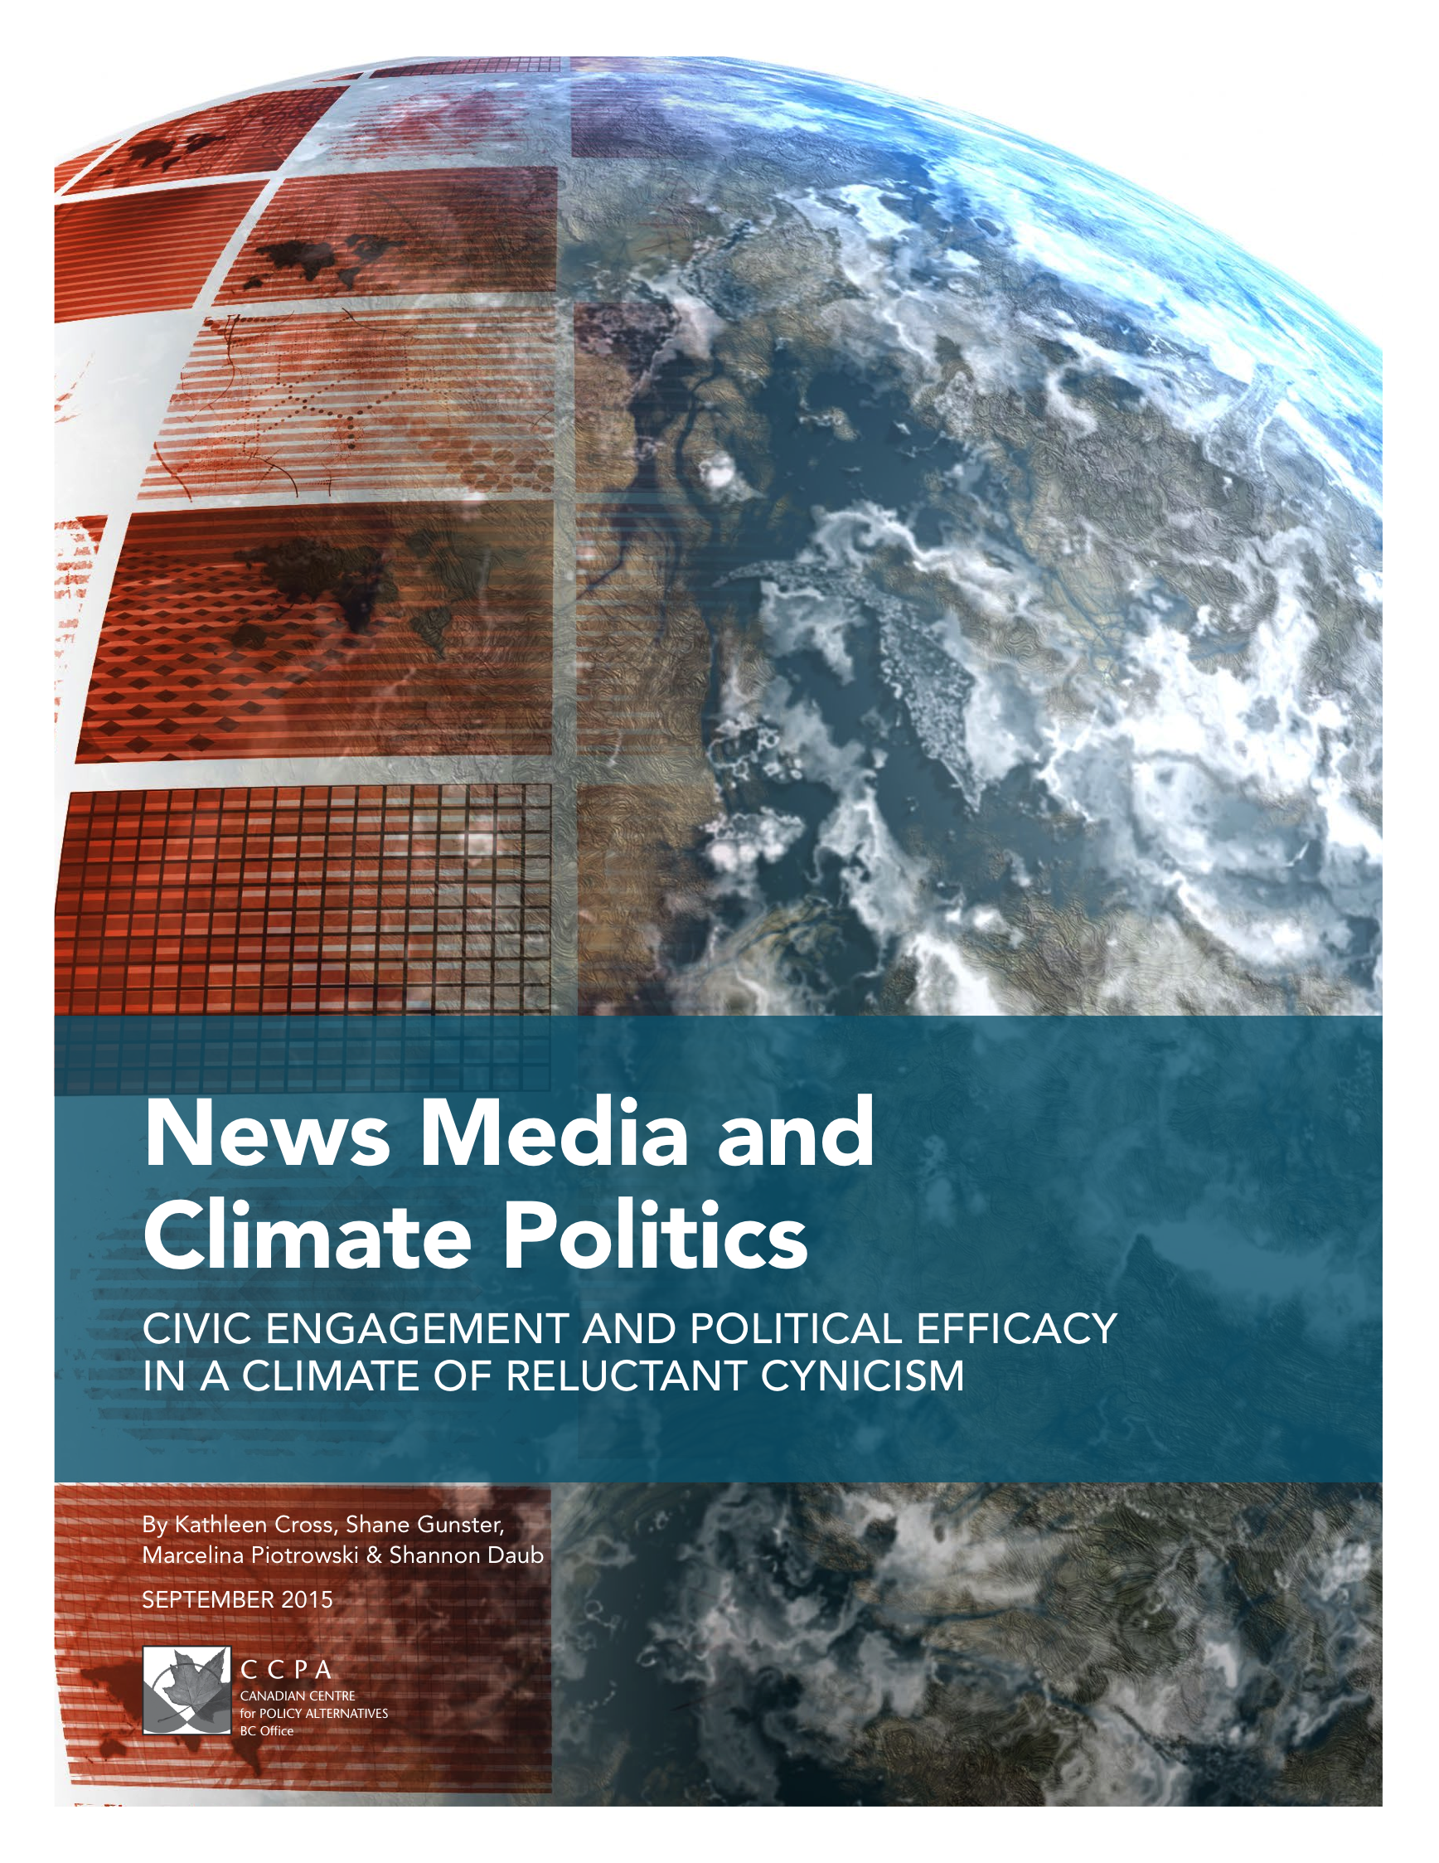
Canadian Centre for Policy Alternatives Study: Focus Groups on
News Framing, Climate Change, and Personal Sense of Efficacy
RELUCTANT CYNICISM
RELUCTANT CYNICISM
RELUCTANT CYNICISM

Slide 3
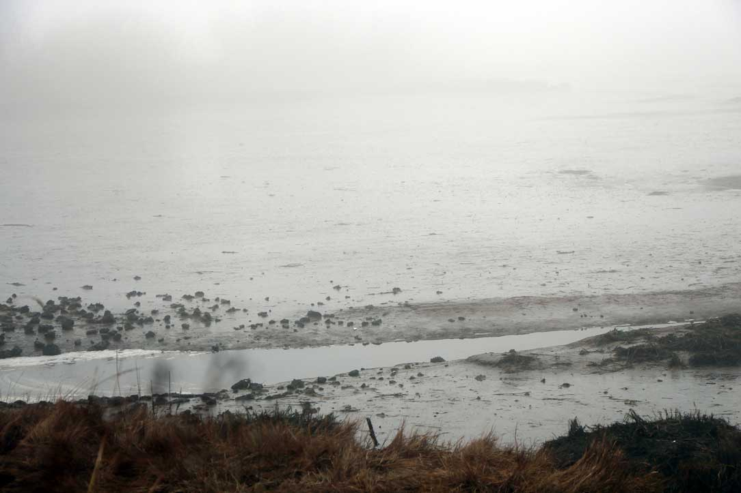
“Still, I’m reluctant to call this pessimism” (Canavan and Stanley Robinson)
__
Science, fictions, and frames: Earth as cradle of life; Space expansion; the singularity; apocalyptic fantasies.
Instead: deep realism of life worlds and new possibilities.
__

Slide 4
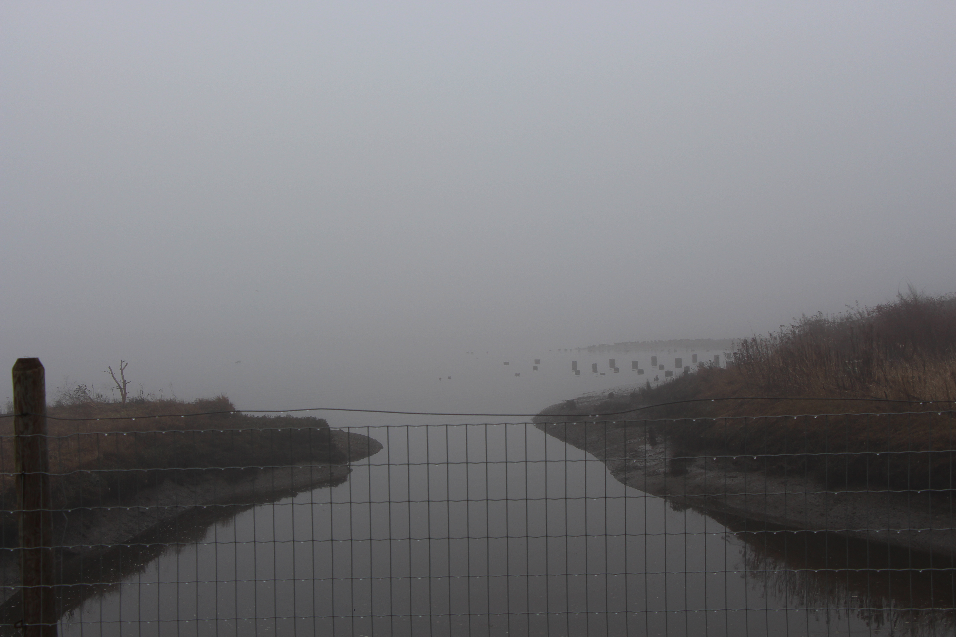
Noticing Stories, Calling for New Narratives:
“Why Restorative Narratives are an Important Part of the Media Landscape” (Tenore) and “Transforming Despair” (Macy and Nurriestearns)
Community narratives: Guilt, avoidance, personal failing, conflict/event based narratives.
Instead: a “great turning” to a life of care that is deep, sustained, connected, and responsive. Opening to pain.
*Note: See “peace journalism.”

Slide 5
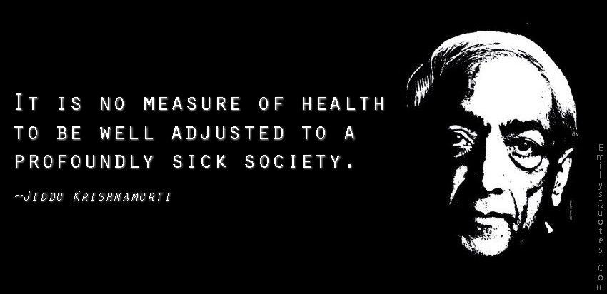
New Boundaries & Spatialities for Habitation… a Call to Notice

Slide 6

“place” vs “space” ; self + place as
Habitus
Thickness of place in use and familiar interactions ; co-creates self ; more place, more self
e.g. Food, water, waste, information entertainment, routes, horizons, etc
Thinned out place – desiccated; leveled out
Use of surface spaces (screens) that can rearrange quickly;
Centralized and delocalized usable “space”; people too; more uniform uses, less “self”
Calls for intervention
…But space can never be pure
space; it is always place
Just as even people highly
programmed to be uniform will
always still be selves connected
to places

Slide 7
In Defense of the Commons – growth, market failure, competition TO – localized collectivities, skilled workmanship, ethics of care, secure frameworks and contingent spaces, “public failure” RISK AGGREGATION, PUBLIC GOOD
Interventions in Habitation
PUBLIC SPACE, SOCIAL GOODS
Astra Taylor: sustainable culture: skilled workmanship,
ethical economies, community food systems
Can add waste
Work less movements
Local movements
Prolonged immersion and engagement (PJ & restorative)
Public info and fb and google as public goods
Existing narrative: rapid growth, market competition
New narrative: a fabric of public good as social security basis and community initiatives – food and broadband; public funding of arts as part of social fabric
*Note: Journalism studies advocates, such as McChesney and Nichols

Slide 8
The Mushroom at the End of the World – promise and ruin; empty space, teleology (culmination); progress; industrial rhythms TO - polyphony, assemblage, pulses, arts of noticing
PRECARITY, ASSEMBLAGE AS INQUIRY

